Slide 1
More insights on the security of RSA key transport

Slide 2
RSA key transport
CLIENT
SERVER
Server’s RSA public Key
RSA-encryption(Pre-Master secret)_{PublicKey}

Slide 3
Is RSA robust against Chosen ciphertext attacks?
[all following operations are assumed mod n]
You see a ciphertext C=Me
Goal: decrypt it, i.e. find M = C^{d}
Attacker power: can access a decryption oracle
But obviously CANNOT submit original data, otherwise trivial!
Attack:
Choose random value r
Construct NEW ciphertext X= (r^{e} C)
Ask oracle to decrypt seemingly innocuous message X
(chosen ciphertext attack)
Oracle will return decryption of X X^{d} = (r^{e} C)^{d} = r^{ed} C^{d} = r C^{d}
Attacker cancels r and finds M! X^{d} r⁻¹ = r C^{d} r⁻¹ = C^{d} = M
multiply by r⁻¹ mod n

Slide 4
Problem: RSA is malleable
Non-malleability: given an encryption c of some message m, the attacker should NOT be able to create a different ciphertext c’ that decrypts to a message m’ that is somehow related to m.
RSA padding: should at least mitigate such problem
But we will see later on whether this is the case… ☹

Slide 5
RSA padding: PKCS #1 v1.5
PKCS #1 = first standard for the family PKCS = Public-Key Cryptography Standards (PKCS)
Specifies RSA encryption and decryption operation, including basic RSA padding approach
Also available as IETF RFC (see original RFC 2313, see also latest one: 8017)
Padding string: at least 8 non-zero bytes
(random, to avoid otherwise trivial CPA attack)
Actual data: no more than k-11 bytes
00
02
rnd
rnd
rnd
rnd
rnd
rnd
rnd
rnd
00
dat
dat
dat
dat
dat
dat
k = size of the RSA modulus in bytes – formally: k = integer value which satisfies
2^{8(k-1)} ≤ n < 2^{8k}
e.g. with RSA-1024, k = 128 (in most cases) → you can encrypt up to 117 bytes

Slide 6
RSA key transport (until SSL v3.0 included)
SERVER
From SSL 3.0 specs:
[…] When the server receives
a client key exchange message
it extracts the ciphertext c and
attempts to decrypt it. If PKCS1
decoding returns reject, the server
sends an abort message to the
client. Otherwise, it continues
normally with session setup.
CLIENT
Server’s RSA public Key
RSA-PKCS#1-v1.5(Pre-Master secret)_{PublicKey}
Decr.OK?
(pad OK?)
No: abort!
Yes: go on
OOOOPPPPSSS!!! Looks like we have a possible Padding Oracle!!!

Slide 7
Bleichenbacher’s Oracle
Daniel Bleichenbacher, 1998
Adaptive Chosen Ciphertext Attack
Against RSA PKCS #1
Targets up to SSL v3.0
Corrected in TLS1.0+
Removed in TLS 1.3 (no more RSA key transport)
But still around
at least until 2017/18!!

Slide 8
Bleichenbacher’s Oracle
Attacker’s goal: decrypt ciphertext C
C=Me mod n
Pick value r and construct new ciphertext
C’ = C r^{e} mod n = (M r)^{e} mod n
Send to SSLv3.0 server
Oracle will tell you if (M r) starts with 0002 or not!
This leaks information about M!
Bleichenbacker’s result: with a sufficient number of attempts (order of 2²⁰ with RSA-1024) you can completely decrypt M!
Adaptive attack: pick r based on previous results!

Slide 9
Toy Bleichenbacher example
Assume a simpler Oracle
Msg = log₂ n bits
Oracle tells if first bit is 0 or 1.
Binary answer, nothing else
Real Bleichenbacher’s attack: same concept, but PKCS#1 padding oracle tells if first 2 bytes are 0002, hence much more elaborate math – see original paper
With order of log₂ n attempts, you can decrypt the WHOLE message!!

Slide 10
Example (see math file)
RSA parameters
p = 13, q=19, n=247 (8 bit)
Let’s pick e=29 → d=e⁻¹ mod 216 = 149
Assume you see C=90
Send to server: Mod[c* PowerMod[2^Range[1, 8], e, n], n] = {20, 224, 187, 69, 180, 40, 201, 127}
Server returns: {0,1,1,1,0,1,1,1}

Slide 11
Example (see math file)
2M starts with 0 if
M in (0, 63) or (124,187)
Of this, 4M starts with 1 if
M in (32, 61) or (156,185)
Of this, 8M starts with 1 if
M in (47, 61) or (171,185)
And so on, 8° attempt, i.e. 256M, will break the last tie!
binary search: linear with #bit!!
Aftermath: as long as one bit gets known, all the ciphertext gets known as well!!
(repeat the example with the parity bit, even easier!)

Slide 12
Corollary: attacking parity
A shop rejects RSA-PKCS#1 encrypted requests for an even number of items
Parity side channel = parity oracle!
Same situation as before: as long as just 1 bit gets revealed, ALL plaintext is at stake!

Slide 13
Bleichenbacher’s Oracle in the wild
Discovered in 1998
Affected SSL up to v3.0
Corrected by TLSv1.0+
But… guess what happened next! side channels → pandora’s box → Bleichenbacker’ saga!
Klima et al. (CHES 2003)
Blei­chen­ba­cher’s At­tack Strikes Again: Brea­king XML En­cryp­ti­on (ESORICS 2012)
Degabriele et al. (CT-RSA 2012)
Bardou et al. (CRYPTO 2012)
Cross-Tenant Side-Channel Attacks in PaaS Clouds (CCS 2014)
Side Channel Attacks to TLS implementations (USENIX 2014)
Attack to QUIC (CCS 2015)
DROWN (USENIX 2016)
Return Of Bleichenbacher's Oracle Threat (USENIX 2018)
The Dangers of Key Reuse: Practical Attacks on IPsec IKE (USENIX 2018)
The 9 Lives of Bleichenbacher's CAT - cache attacks (IEEE S&P 2019)
2019 CAT paper, coauthored by Adi Shamir:
the inventor of RSA now recommending to deprecate RSA in TLS!

Slide 14
Recent examples of Bleichenbacher’s Oracle in the wild
2016: DROWN attack to TLS
Use Bleichenbacher with SSLv2
SSLv2? Are you kidding? Affects 1/3 of the sites, including major ones!
2018: ROBOT attack
Extensive large scale analysis: quite a few poor implementations!
IPSEC IKE issues (2018)
combine Bleichenbacher with downgrade to IKEv1.0
Vulnerabilities in Cisco (CVE-2018-0131), Huawei (CVE-2017-17305), Clavister (CVE-2018-8753), and ZyXEL (CVE-2018-9129)

Slide 15
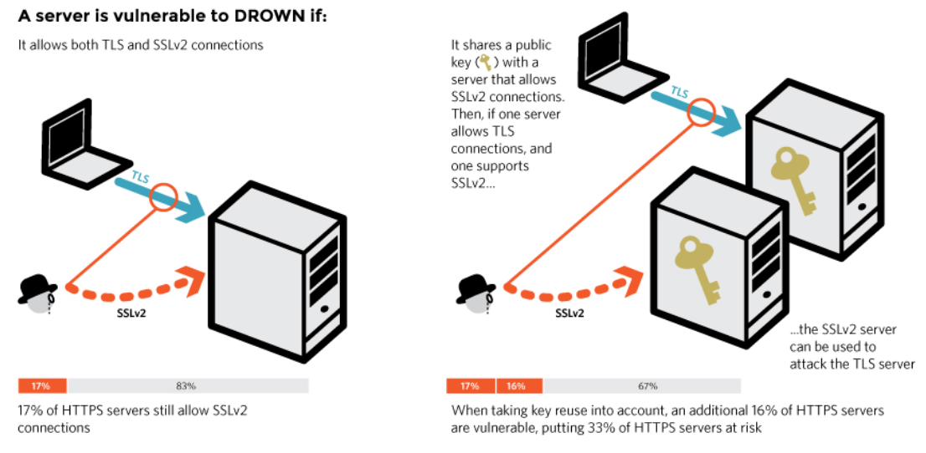
DROWN attack (2016)
Source: https://drownattack.com/

Slide 16
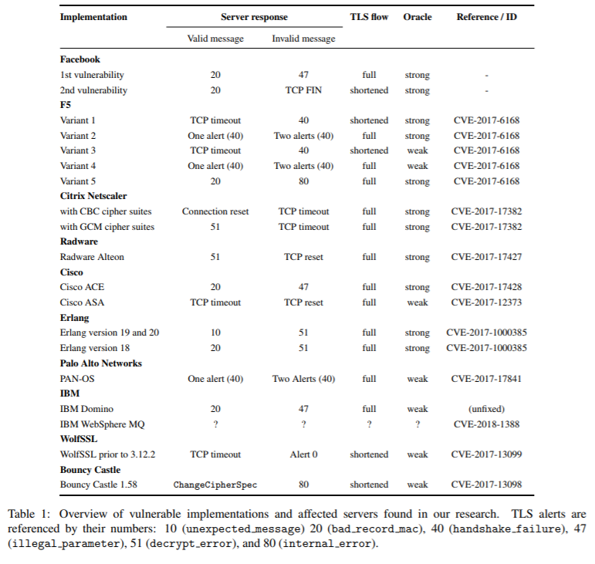
How critical can it get? TLS implementations: a jungle!! lots of oracles until last year!! Source: ROBOT 2018 USENIX SEC

Slide 17
How critical can it get? TLS implementations: a jungle!! lots of oracles until last year!! Source: ROBOT 2018 USENIX SEC
See relevant talk @ USENIX Security 2018
https://www.youtube.com/watch?v=037D7YZCpSM

Slide 18
Countermeasures
Change RSA-PKCS#1-v1.5 into more secure padding
E.g., RSA-OAEP
Way too major change!! Declined!
Careful implementation
If padding malformed, follow up as if it were properly formed…
But not nearly easy!!
See many more SUBTLE issues at https://eprint.iacr.org/2003/052.pdf
Also shows that random generation of 48 bytes is not secure
In fact, many implementations messed up!
Get rid of RSA key transport…
Well, this is what TLSv1.3 has done!

Slide 19

Take-home messages
Implementation is very tricky! And errors last for long
Once crypto error is made (e.s. original SSL) it’s hard to incrementally patch it
Somewhat reminds me the MAC-then-encrypt saga… (also ending with removal from TLSv1.3)
Even security folks might not fully grasp crypto attacks
Fun slide in ROBOT’s presentation
When talking about responsible disclosure:
Hey, your server is vulnerable to the Bleichenbacher attack
No worries. We use military grade encryption

